Slide 1
Lecture 01 - Introduction, Types of Variables, LoM, and Data Summarization/Visualization
Data Analysis (CJUS 6103)
Data Analysis (CJUS 6103)
Lecture 01 - Introduction, Types of Variables, LoM, and Data Summarization/Visualization

Slide 2
Science, Methods, & Replication
▶ What is Science?
"The process of gathering and analyzing data in a systematic and controlled way using procedures that are generally accepted by others in the discipline."
▶ Methods? Replication?
Methods: Procedures used in processing and analyszing data.
Replication: Repeating methods with the same data in an effort to achive the same results.
Data Analysis (CJUS 6103)
Lecture 01 - Introduction, Types of Variables, LoM, and Data Summarization/Visualization

Slide 3
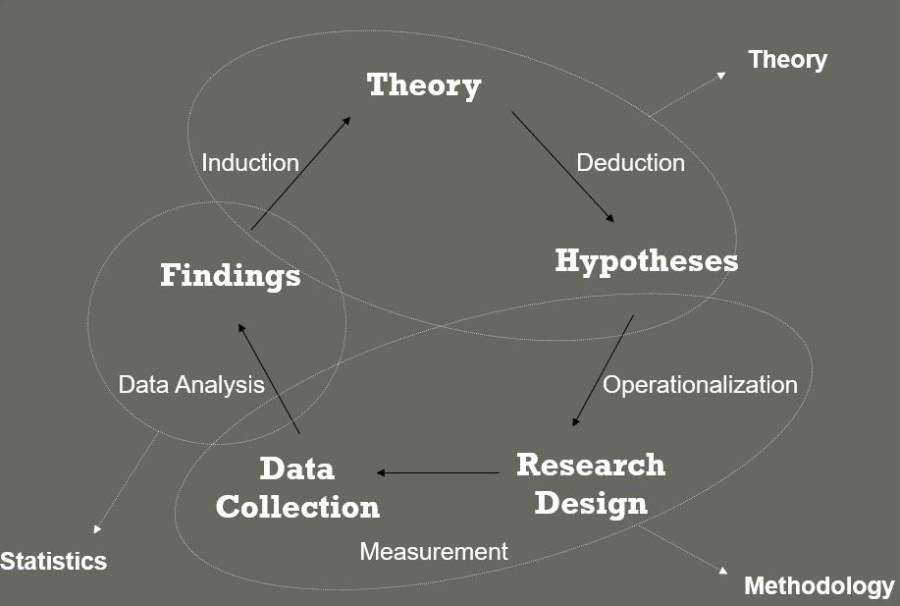
Wheel of Science
Data Analysis (CJUS 6103)
Lecture 01 - Introduction, Types of Variables, LoM, and Data Summarization/Visualization

Slide 4
Types of Statistical Research
▶ Evaluation
Examines program/law/law enforcement outcomes
▶ Exploratory
Examines unfamiliar topics lacking previous research
▶ Descriptive
Examines a particular phenomenon in a particular sample
Data Analysis (CJUS 6103)
Lecture 01 - Introduction, Types of Variables, LoM, and Data Summarization/Visualization

Slide 5
Populations and Samples
▶ What is a Population?
‘The universe of people, objects, or locations that researchers wish to study.’
▶ What is a Sample?
‘A subset pulled from a population with the goal of ultimately using the people, objects, or places in the sample as a way to generalize to the population.’
▶ What is Probability Sampling?
Data Analysis (CJUS 6103)
Lecture 01 - Introduction, Types of Variables, LoM, and Data Summarization/Visualization

Slide 6
Types of Variables and Levels of Measurement
Outline
▶ Units of Analysis
▶ Variables
▶ Levels of Measurement
Nominal
Ordinal
Interval
Ratio
▶ Levels of Measurement Examples
Data Analysis (CJUS 6103)
Lecture 01 - Introduction, Types of Variables, LoM, and Data Summarization/Visualization

Slide 7
Units of Analysis
What is a unit of analysis?
▶ The objects or targets of a research study.
▶ Examples:
A researcher is examining homicide patterns over time by gathering yearly city-level data for the years 1980-1985.
▶ What is the unit of analysis?
A researcher is aiming to evaluate the effectiveness of ‘fighting back’ during a violent incident as it relates to injuries.
▶ What is the unit of analysis?
Data Analysis (CJUS 6103)
Lecture 01 - Introduction, Types of Variables, LoM, and Data Summarization/Visualization

Slide 8
Variables
▶ What is a variable?
‘A characteristic that describes people, objects, or places and takes on multiple values in a sample or population.’
▶ What makes a constant different from a variable?
A constant only takes on one value, whereas a variable takes on multiple values.
Data Analysis (CJUS 6103)
Lecture 01 - Introduction, Types of Variables, LoM, and Data Summarization/Visualization

Slide 9
Levels of Measurement
▶ Levels of Measurement and Computerization
Quantitative analyses require that data are computerized and numbers are assigned to all categories.
Level of measurement represents how these numbers are to be interpreted.
▶ Are the numbers arbitrary, or do they have specific meanings?
Four Levels of Measurement
▶ Nominal, Ordinal, Interval, Ratio (NOIR)
Data Analysis (CJUS 6103)
Lecture 01 - Introduction, Types of Variables, LoM, and Data Summarization/Visualization

Slide 10
Nominal Variables
▶ What is a nominal variable?
A variable whose numeric values can only be interpreted as representing distinct categories (i.e., 1=red; 2=blue; . . . ).
▶ What are the properties of these categories?
Distinct
Mutually Exclusive
Exhaustive
▶ What are some example of nominal variables?
Religion
Marital status
Race
Data Analysis (CJUS 6103)
Lecture 01 - Introduction, Types of Variables, LoM, and Data Summarization/Visualization

Slide 11
Ordinal Variables
▶ What is an ordinal variable?
A variable whose values can be rank-ordered in terms of ‘more than’ or ‘less than’.
▶ Values have a logical order:
Likert Scales:
▶ Opinions – (1) Strongly Disagree; (2) Disagree; (3) No Opinion; (4) Agree; (5)
Strongly Agree
Year in School – (1) Freshman; (2) Sophomore; (3) Junior; (4) Senior
Data Analysis (CJUS 6103)
Lecture 01 - Introduction, Types of Variables, LoM, and Data Summarization/Visualization

Slide 12
Interval Variables
▶ What is an interval level variable?
A variable whose distance between two adjacent values is fixed and known.
Allows more detailed descriptions of why one value is ‘more than’ or ‘less than’ the other.
Value of ‘0’ is arbitrary, and does not signal that the phenomenon in question is
entirely absent.
▶ 0 degrees Fahrenheit is not an absence of temperature.
▶ What are some examples of interval variables?
Temperature
IQ Tests
Data Analysis (CJUS 6103)
Lecture 01 - Introduction, Types of Variables, LoM, and Data Summarization/Visualization

Slide 13
Ratio Variables
▶ What is a ratio level variable?
A variable whose value of zero is meaningful (making multiplication and division possible).
i.e., a homicide rate of 10 per 100,000 is twice that of 5 per 100,000.
▶ What are some examples of ratio level variables?
Age
Years of education
Weight
Income
Data Analysis (CJUS 6103)
Lecture 01 - Introduction, Types of Variables, LoM, and Data Summarization/Visualization

Slide 14
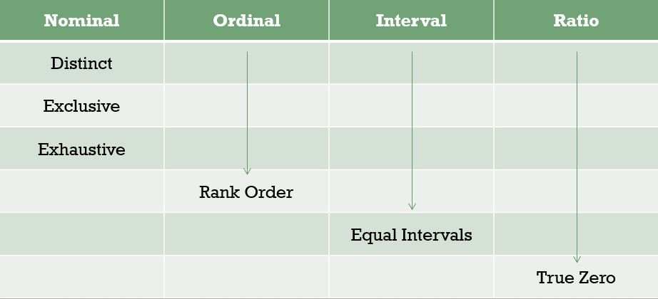
Review of Level of Measurement
Data Analysis (CJUS 6103)
Lecture 01 - Introduction, Types of Variables, LoM, and Data Summarization/Visualization

Slide 15
Levels of Measurement Examples
What level of measurement is applicable for each of the following?
▶ Property crime rate
▶ Crime type (violent, property, drug)
▶ Sentence length (in months)
▶ Fear of crime (1-10)
▶ Conviction status (convicted/not convicted)
▶ Crime seriousness (1-100)
▶ Number of arrests
Data Analysis (CJUS 6103)
Lecture 01 - Introduction, Types of Variables, LoM, and Data Summarization/Visualization

Slide 16
Alternative Ways of Classifying Variables
▶ Qualitative (Nominal/Ordinal)
Variables tel us "what kind," "what group," or "what type."
Marital status, religion, race, liberalism, conservativism
▶ Quantitative (Interval/Ratio)
Variables tell us "how much," or "how many."
Hours worked a week, sentence length (in months), crime rates
Data Analysis (CJUS 6103)
Lecture 01 - Introduction, Types of Variables, LoM, and Data Summarization/Visualization

Slide 17
Alternative Ways of Classifying Variables (cont.)
▶ Discrete
Values assume only a finite or countable number of alternatives
▶ Number of crimes, family size, number of convictions
▶ Cannot have part of any one of those units - e.g., no 1.5 crimes committed
▶ Continuous
Values can assume theoretically infinite number of values between any two points on a scale
▶ Crime rates per 100,000, GPA, arrest rates
▶ Can have 3.5 murders per 100,000 population or 13.33 arrests per 100 reported offenses
Data Analysis (CJUS 6103)
Lecture 01 - Introduction, Types of Variables, LoM, and Data Summarization/Visualization

Slide 18
Alternative Ways of Classifying Variables (cont.)
Independent Variable (X) = “Cause,” “Predictor,” “Regressor,” “Covariate,” list goes on. . . .(sometimes referred to as controls, also)
Dependent Variable (Y) = “Effect,” “Outcome,” “Response,” list goes on. . . (but not as far as for IVs)
Note: not so much a way of classifying measurement, but classifying what side of a regression equation the variable is on. Left-hand side variables are the DV,
right-hand side variables are the IVs.
REMEMBER: An independent variable in one context can be the dependent variable in another. The side of the equation they are on depends entirely on the research question.
Data Analysis (CJUS 6103)
Lecture 01 - Introduction, Types of Variables, LoM, and Data Summarization/Visualization

Slide 19
Examples
Nationwide, the average starting salary for entry-level police officers is about
$24,000. You believe that the location of police departments in urban vs. rural areas influences starting salaries. In a random sample of 90 police departments, you find that the average starting salary is $25,000 in urban departments and
$24,000 in rural departments.
▶ Unit of observation = Police department
▶ Population = All police departments in U.S.
▶ Sample = 90 police departments
▶ Dependent variable = Starting salary
Ratio level, continuous (also discrete)
▶ Independent variable = Location
Nominal
Data Analysis (CJUS 6103)
Lecture 01 - Introduction, Types of Variables, LoM, and Data Summarization/Visualization

Slide 20
Examples (cont.)
Many sociologists argue that poverty is a cause of criminal behavior. To test this claim, you collect data from a random sample of 250 counties across the U.S. You obtain measures of the poverty rate (% population living below poverty line) and the number of offenses reported to the police.
▶ Unit of observation = County
▶ Population = All counties in U.S.
▶ Sample = 250 counties
▶ Dependent variable = Number of offenses reported to police
Ratio level, discrete
▶ Independent variable = Percent living below poverty line
Ratio level, continuous
Data Analysis (CJUS 6103)
Lecture 01 - Introduction, Types of Variables, LoM, and Data Summarization/Visualization

Slide 21
Examples (cont.)
According to some theorists, teenagers who spend more time with their friends in unsupervised activities are more likely to engage in delinquent conduct. You question a random sample of 2,500 high-school youths about number of hours spent in unsupervised peer activities (e.g., cruising, shopping, movies) and frequency of delinquent behavior.
▶ Unit of observation = Individual
▶ Population = All high-school youth
▶ Sample = 2,500 high-school youths
▶ Dependent variable = Frequency of delinquent behavior
Ratio level, discrete
▶ Independent variable = Hours in unsupervised peer activities
Ratio level, continuous
Data Analysis (CJUS 6103)
Lecture 01 - Introduction, Types of Variables, LoM, and Data Summarization/Visualization

Slide 22
Why Does Level of Measurement Matter?
Level of measurement determines what type of statistical test is appropriate. Tests are chosen based upon the lecel of measurement of the IVs and DV.
▶ Examples
X = Sex, Y = Employment(Y/N) = Chi-Square Test
X = Sex, Y = Number of Arrests = t-Test
X = Crime Type, Y = Sentence Length (in months) = F-Test
X = Divorce Rate, Y = Homicide Rate = Correlation and Regression
Data Analysis (CJUS 6103)
Lecture 01 - Introduction, Types of Variables, LoM, and Data Summarization/Visualization

Slide 23
Data Summarization
Section Outline
▶ Proportions & Percents
▶ Rates & Ratios
▶ Proportion/Percent Difference (Change)
▶ Frequency Distributions with...
Nominal data
Ordinal data
Interval/Ratio data
Data Analysis (CJUS 6103)
Lecture 01 - Introduction, Types of Variables, LoM, and Data Summarization/Visualization

Slide 24
Summarizing Data
▶ Sample size (n)
Total number of observations in a sample
▶ Frequency (f)
Count or number of observations in a subset of the sample
Data Analysis (CJUS 6103)
Lecture 01 - Introduction, Types of Variables, LoM, and Data Summarization/Visualization

Slide 25
Proportion and Percent
▶ Proportion (p)
– Ratio of the number of observations in a subset of the sample to the total number of cases in the sample (relative frequency)
_{– p =} # in subset of sample ₌ f
Total # of cases in sample n
▶ Percent (%)
– % = ^{f} ∗ 100
n
Data Analysis (CJUS 6103)
Lecture 01 - Introduction, Types of Variables, LoM, and Data Summarization/Visualization

Slide 26
Ratios and Rates
▶ Ratio
Expresses the relationship between two values, indicating their relative sizes.
e.g., 2:1 indicates that the first value occurs twice as much as the second value
▶ Rate
Ratio of the number of occurrenses of an event to the population at risk for experiencing the event.
_{– Rate =} # of occurrences of an event _{∗ 10 to some power}
estimated population at risk
Data Analysis (CJUS 6103)
Lecture 01 - Introduction, Types of Variables, LoM, and Data Summarization/Visualization

Slide 27
Rates (cont.)
▶ Birth Rates = X 10³ (per 1,000 women of childbearing age)
▶ School expenditure = X 10⁰ (per pupil)
▶ Crime rates = X 10⁵ (per 100,000 population)
In 2016, there were 332,198 robberies reported to the police, and the estimated population in the U.S. that year was 323,127,513
102.8 robberies per 100,000 population
– ³³²¹⁹⁸ ∗ 100000 = 102.8
323127513
Data Analysis (CJUS 6103)
Lecture 01 - Introduction, Types of Variables, LoM, and Data Summarization/Visualization

Slide 28
Rates (cont.)
Difference between a rate and a proportion?}
▶ Proportions cannot lie outside 0,1 interval.
Rates can be anywhere between 0 and ∞
▶ Denominator of a proportion is a fixed sample size (n)
Denominator of a rate is often an estimated population size
Data Analysis (CJUS 6103)
Lecture 01 - Introduction, Types of Variables, LoM, and Data Summarization/Visualization

Slide 29
Calculating Crime Rates
Which region had the most robberies in 2016?
Region | Count | p
Northeast | 53033 | 0.16
Midwest | 64022 | 0.19
South | 128842 | 0.39
West | 86301 | 0.26
Total | 332198 | 1.00
Why does the South have more robberies?
▶ More dangerous?
▶ More people?
Data Analysis (CJUS 6103)
Lecture 01 - Introduction, Types of Variables, LoM, and Data Summarization/Visualization

Slide 30
Calculating Crime Rates (cont.)
Does the South have the highest crime rate?
Region | Count | Population | Rate per 100k
Northeast | 53033 | 56209510 | 94.35
Midwest | 64022 | 67941429 | 94.23
South | 128842 | 122319574 | 105.33
West | 86301 | 76657000 | 112.58
▶ West is actually more dangerous (by a hair)
– Rates account for differences in the eligible population, or the population at risk
Data Analysis (CJUS 6103)
Lecture 01 - Introduction, Types of Variables, LoM, and Data Summarization/Visualization

Slide 31
Proportional Difference
▶ Proportional Difference (Change)
– Comparison of a single variable across two time periods, or simply to compare the relative magnitudes of two values.
▶ Typically multiplied by 100 to get a percent difference
_{▶ Percent difference =} Time 2 - Time 1 _{∗ 100 or} Comparison - Baseline _{∗ 100}
Time 1 Baseline
Data Analysis (CJUS 6103)
Lecture 01 - Introduction, Types of Variables, LoM, and Data Summarization/Visualization

Slide 32
Proportional Difference (cont.)
▶ Change in homicide rate
– 2011 Rate = 4.7 per 100,000
– 2016 Rate = 5.3 per 100,000
▶ How large was the increase in the homicide rate?
– Percent Difference = ^{Time 2 - Time 1} ∗ 100 = ^{5.3 - 4.7} ∗ 100 = 12.8
Time 1 4.7
▶ Homicide rate increased 12.8% from 2011 to 2016
Data Analysis (CJUS 6103)
Lecture 01 - Introduction, Types of Variables, LoM, and Data Summarization/Visualization

Slide 33
Proportional Difference (cont.)
Homicide rate (per 100,000) by region:
Region (# of states) | 2011 | 2016 | % Change
New England (6) | 2.6 | 2.0 | -23.1
Middle Atlantic (3) | 4.4 | 4.0 | -9.1
East North Central (5) | 4.9 | 6.4 | 30.6
West North Central (7) | 3.4 | 4.3 | 26.5
South Atlantic (8) | 5.4 | 6.4 | 18.5
East South Central (4) | 5.7 | 7.3 | 28.1
West South Central (4) | 5.4 | 6.3 | 16.7
Mountain (8) | 4.4 | 4.7 | 6.8
Pacific (5) | 4.1 | 4.4 | 7.3
Which region experienced the largest change?
Data Analysis (CJUS 6103)
Lecture 01 - Introduction, Types of Variables, LoM, and Data Summarization/Visualization

Slide 34
Proportional Difference (cont.)
▶ Alternative way to compute percent difference
– Subtract 1.0 from the ratio of the comparison (T2) to baseline (T1)
(
Time 2 - Time 1 Time 1
) (
Time 2 Time 1
Time 1 Time 1
) (
Time 2 Time 1
)
Percent Difference =
∗ 100 =
−
∗ 100 =
− 1 ∗ 100
Data Analysis (CJUS 6103)
Lecture 01 - Introduction, Types of Variables, LoM, and Data Summarization/Visualization

Slide 35
Proportional Difference (cont.)
▶ Proportional/Percent difference can be misleading with a low baseline.
A 100% increase from a baseline of 1 is not as notable as a 100% increase from a baseline of 50
▶ Useful to report both the baseline value as well as the proportion/percent difference (change)
▶ Change and difference are not interchangeable terms, but equation is the same
Change refers to a contrast across temporal units
Difference refers to a contrast between two units at the same time period
Data Analysis (CJUS 6103)
Lecture 01 - Introduction, Types of Variables, LoM, and Data Summarization/Visualization

Slide 36
Frequency Distributions
▶ A kind of data table that is a usefule way to summarize data.
Table should list categories and frequencies, at a minimum.
Often lists proportions and percents, also.
▶ Provides visualization of how cases are spread out across categories/values.
Data Analysis (CJUS 6103)
Lecture 01 - Introduction, Types of Variables, LoM, and Data Summarization/Visualization

Slide 37
Frequency Distributions with Nominal Data
▶ Display f, n, p, %
Family Structure | f | p | %
Both Biological Parents | 3350 | .483 | 48.3
One biological/one step | 1002 | .145 | 14.5
Biological mom only | 1972 | .285 | 28.5
Biological dad only | 233 | .034 | 3.4
Other family member | 372 | .054 | 5.4
Total | 6929 | 1.001 | 100.1
▶ HINT: Make sure the proportions add up to within rounding error of 1.0
Data Analysis (CJUS 6103)
Lecture 01 - Introduction, Types of Variables, LoM, and Data Summarization/Visualization

Slide 38
Frequency Distributions with Nominal Data (cont.)
▶ Can be informative to compare 2+ groups
White Youth
Black Youth
p %
Family Structure f
p
%
f
Both bio parents | 2743 | .594 | 59.4 | 607 | .263 | 26.3
One bio/one step | 706 | .153 | 15.3 | 296 | .128 | 12.8
Bio mom only | 864 | .187 | 18.7 | 1108 | .480 | 48.0
Bio dad only | 172 | .037 | 3.7 | 61 | .026 | 2.6
Other family | 136 | .029 | 2.9 | 236 | .102 | 10.2
Total | 4621 | 1.000 | 100 | 2308 | .999 | 99.9
▶ How does family structure differ?
Data Analysis (CJUS 6103)
Lecture 01 - Introduction, Types of Variables, LoM, and Data Summarization/Visualization

Slide 39
Frequency Distributions with Ordinal Data
▶ Can add cumulatives (cf, cp, c%)
– Cumulative frequency is the frequency of a row plus all preceding rows
Grades in 8th | f | p | % | cf | cp | c%
A’s & B’s | 3186 | .370 | 37.0 | 3186 | .370 | 37.0
B’s & C’s | 3238 | .376 | 37.6 | 6424 | .746 | 74.6
C’s & D’s | 1850 | .215 | 21.5 | 8274 | .961 | 96.1
D’s & F’s | 330 | .038 | 3.8 | 8604 | .999 | 99.9
Total | 8604 | .999 | 99.9
▶ Notice that the cf of the last row is equal to n
Data Analysis (CJUS 6103)
Lecture 01 - Introduction, Types of Variables, LoM, and Data Summarization/Visualization

Slide 40
Women Really Are Smarter
▶ Use % to determine if young males or females perform better academically.
– What percentage get B’s & C’s or better?
Males Females
Grades in 8th | % | c% | % | c%
A’s & B’s | 29.3 | 29.3 | 45.2 | 45.2
B’s & C’s | 38.9 | 68.2 | 36.3 | 81.5
C’s & D’s | 26.8 | 95.0 | 16.0 | 97.5
D’s & F’s | 5.0 | 100.0 | 2.6 | 100.1
Total | 100.0 |  | 100.1
Data Analysis (CJUS 6103)
Lecture 01 - Introduction, Types of Variables, LoM, and Data Summarization/Visualization

Slide 41
Frequency Distributions with Discrete, Interval-Ratio Data
▶ Do delinquents spend their free time differently than non-delinquents?
Non-delinquents Delinquents
# of Weekdays Do Homework? | % | c% | % | c%
0 | 8.4 | 8.4 | 14.8 | 14.8
1 | 3.3 | 11.7 | 5.1 | 19.9
2 | 7.5 | 19.2 | 10.4 | 30.3
3 | 17.5 | 36.7 | 21.0 | 51.3
4 | 24.4 | 61.1 | 19.8 | 71.1
5 | 38.8 | 99.9 | 29.0 | 100.1
Total | 99.9 |  | 100.1
Data Analysis (CJUS 6103)
Lecture 01 - Introduction, Types of Variables, LoM, and Data Summarization/Visualization

Slide 42
Frequency Distributions with Discrete, Interval-Ratio Data
▶ Number of months sentenced for armed robbery (n=40)
– 36 38 39 47 50 51 51 53
– 55 55 56 57 60 62 63 64
– 64 66 67 68 69 70 70 70
– 71 75 78 79 80 80 81 83
– 85 86 87 89 95 98 99 99
▶ What would be the problem with creating a frequency distribution with these data?
Data Analysis (CJUS 6103)
Lecture 01 - Introduction, Types of Variables, LoM, and Data Summarization/Visualization

Slide 43
Simple Frequency Distribution of Sentence Length
Sentence Length | f | Sentence Length | f | Sentence Length | f
36 | 1 | 62 | 1 | 79 | 1
38 | 1 | 63 | 1 | 80 | 2
39 | 1 | 64 | 2 | 81 | 1
47 | 1 | 66 | 1 | 83 | 1
50 | 1 | 67 | 1 | 85 | 1
51 | 2 | 68 | 1 | 86 | 1
53 | 1 | 69 | 1 | 87 | 1
55 | 2 | 70 | 3 | 89 | 1
56 | 1 | 71 | 1 | 95 | 1
57 | 1 | 75 | 1 | 98 | 1
60 | 1 | 78 | 1 | 99 | 2
Lots of 1s in the frequency columns - makes it more difficult to understand how sentence length is distributed.
43
Data Analysis (CJUS 6103)
Lecture 01 - Introduction, Types of Variables, LoM, and Data Summarization/Visualization

Slide 44
Grouped Frequency Distributions
▶ A grouped frequency distribution can come in handy for certain types of data.
Discrete, interval-ratio data with a large number of values.
Continuous, interval-ratio data.
▶ Groups values into ’classes’ or intervals.
▶ Frequency distribution of these classes.
▶ Transforms quantitative data into qualitative (ordinal) data.
Data Analysis (CJUS 6103)
Lecture 01 - Introduction, Types of Variables, LoM, and Data Summarization/Visualization

Slide 45
Steps in Creating a Grouped Frequency Distribution
▶ Arrange raw data in ascending order
▶ Choose the number of intervals (generally 5-10 will do)
▶ Determine the width of the intervals
Calculate the range of the data (99-36=63)
Divide by the # of desired intervals (63/6=10.5)
Round to a convenient interval width (10)
▶ A multiple of five is usually the easiest
Data Analysis (CJUS 6103)
Lecture 01 - Introduction, Types of Variables, LoM, and Data Summarization/Visualization

Slide 46
Steps in Creating a Grouped Frequency Distribution (cont.)
▶ Construct the interval limits
Choose the lower limit of the 1st interval (35)
▶ Again, easier if the lower limit is a multiple of five
Add interval width to get the 1st interval (35-44)
▶ You can’t just add the interval width to the 1st lower limit; you must include the lower limit in your count
Construct non-overlapping intervals such that the 1st interval contains the smallest value and the final interval contains the largest value
▶ Tally the number of cases that fall into each interval
Make sure the frequencies add up to n
Data Analysis (CJUS 6103)
Lecture 01 - Introduction, Types of Variables, LoM, and Data Summarization/Visualization

Slide 47
Steps in Creating a Grouped Frequency Distribution (cont.)
Sentence Length | f | p | %
35 - 44 | 3 | .075 | 7.5
45 - 54 | 5 | .125 | 12.5
55 - 64 | 9 | .225 | 22.5
65 - 74 | 8 | .200 | 20.0
75 - 84 | 7 | .175 | 17.5
85 - 94 | 4 | .100 | 10.0
95 - 104 | 4 | .100 | 10.0
Total | 40 | 1.0 | 100.0
Data Analysis (CJUS 6103)
Lecture 01 - Introduction, Types of Variables, LoM, and Data Summarization/Visualization

Slide 48
Frequency Distributions with Continuous, Interval-Ratio Data
▶ State-level unemployment rates, 2016
– 2.8 2.8 3.0 3.2 3.2 3.3 3.3 3.4 3.7 3.7
– 3.8 3.9 3.9 4.0 4.0 4.1 4.1 4.2 4.3 4.4
– 4.4 4.5 4.6 4.8 4.8 4.8 4.9 4.9 4.9 4.9
– 4.9 5.0 5.0 5.1 5.1 5.3 5.3 5.3 5.4 5.4
– 5.4 5.4 5.7 5.8 5.9 6.0 6.0 6.1 6.6 6.7
▶ ∼ Intervals; Range = 6.7-2.8=3.9
– Width = 3.9/9 = .43 - ∼ .5
– 1st interval: 2.5-2.9
Data Analysis (CJUS 6103)
Lecture 01 - Introduction, Types of Variables, LoM, and Data Summarization/Visualization

Slide 49
Frequency Distribution for State-Level Unemployment
This one is for you to finish on your own (I’ll provide the answer in the lecture notes).
Interval Limits f p % 2.5-2.9
Total
Data Analysis (CJUS 6103)
Lecture 01 - Introduction, Types of Variables, LoM, and Data Summarization/Visualization

Slide 50
Graphing Data
Outline
▶ Graphing Qualitative Data
Pie Charts
Bar Graphs
▶ Graphing Quantitative Data
Histogram
Polygon
▶ Other Useful Graphing Techniques
Time Series
Map
Data Analysis (CJUS 6103)
Lecture 01 - Introduction, Types of Variables, LoM, and Data Summarization/Visualization

Slide 51
Graphing Qualitative Data
▶ Pie Charts
Each category receives a "slice" of the pie
Best if there are no more than five categories to make interpretation clear
Label categories; percents should sum to 100
▶ Bar Graphs
Each category gets a bar and a label
Use spaces between bars to imply distinct categories (especially for nominal data)
Y-axis xan measure f, p, or %
Put the frequency (or p or %) above each bar
Data Analysis (CJUS 6103)
Lecture 01 - Introduction, Types of Variables, LoM, and Data Summarization/Visualization

Slide 52
Family Structure - Pie Chart
Family Structure, n=6929
28%
Bio Dad Bio Mom Both Bio
One Bio/One Step Other Family
3%
5%
48%
14%
Data Analysis (CJUS 6103)
Lecture 01 - Introduction, Types of Variables, LoM, and Data Summarization/Visualization

Slide 53
Family Structure by Race - Pie Charts
White Youth
White Youth, n=4621
19%
Bio Dad Bio Mom Both Bio
One Bio/One Step Other Family
4%
59%
3%
15%
Data Analysis (CJUS 6103)
Lecture 01 - Introduction, Types of Variables, LoM, and Data Summarization/Visualization

Slide 54
Family Structure by Race - Pie Charts
Black Youth
Black Youth, n=2308
48%
Bio Dad Bio Mom Both Bio
One Bio/One Step Other Family
3%
10%
26%
13%
Data Analysis (CJUS 6103)
Lecture 01 - Introduction, Types of Variables, LoM, and Data Summarization/Visualization

Slide 55
Scholastic Performance Bar Graph
37
37.6
30
Percent
20
21.5
10
3.8
0
A's & B's
B's & C's
grades
C's & D's
D's & F's
55
Data Analysis (CJUS 6103)
Lecture 01 - Introduction, Types of Variables, LoM, and Data Summarization/Visualization

Slide 56
Scholastic Performance Bar Graph
45.2
40
38.9
36.3
30
29.3
26.8
sex
Percent
Female
Male
20
16
10
5
2.6
0
A's & B's
B's & C's
grades
C's & D's
D's & F's
Data Analysis (CJUS 6103)
Lecture 01 - Introduction, Types of Variables, LoM, and Data Summarization/Visualization

Slide 57
Graphing Quantitative Data
▶ Histogram
Bars should touch to imply that original data are quantitative in nature (interval-ratio)
Y-axis can be measured with f, p, or %
X-axis should be labeled with values or interval limits
▶ Polygon
Dot placed at midpoint of each interval, with a line to connect the dots together
Line should connect to the x-axis
Both types of graphs provide visualize evidence of skew in the distribution of values.
Data Analysis (CJUS 6103)
Lecture 01 - Introduction, Types of Variables, LoM, and Data Summarization/Visualization

Slide 58
Robbery Sentence Length Histogram
7.5
5.0
count
2.5
0.0
50
70
sent_length
90
Data Analysis (CJUS 6103)
Lecture 01 - Introduction, Types of Variables, LoM, and Data Summarization/Visualization

Slide 59
Robbery Sentence Length Polygon
8
6
count
4
2
0
20
40
60
sent_length
80
100
Data Analysis (CJUS 6103)
Lecture 01 - Introduction, Types of Variables, LoM, and Data Summarization/Visualization

Slide 60
Other Useful Graphing Techniques
▶ Time Series
Line graph where X-axis represents time, often in years
Displays temporal trends
▶ Can overlay a trend line to see how some characteristic increases or decreases over time.
▶ Map
Useful for displaying census-related data
Displays spatial trends
Data Analysis (CJUS 6103)
Lecture 01 - Introduction, Types of Variables, LoM, and Data Summarization/Visualization

Slide 61
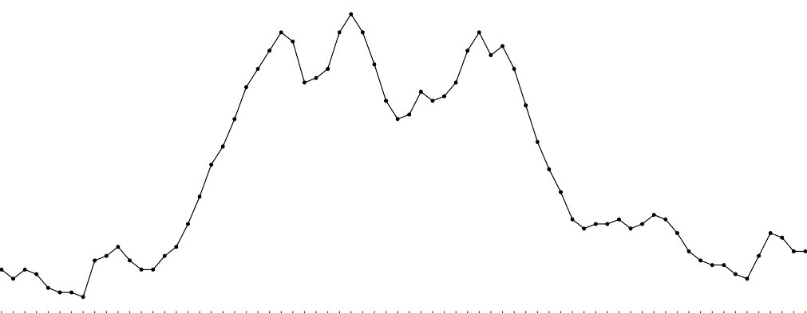
Homicide Rates, 1950 - 2019 Time Series
10
8
hom_rate
6
4
1950
1951
1952
1953
1954
1955
1956
1957
1958
1959
1960
1961
1962
1963
1964
1965
1966
1967
1968
1969
1970
1971
1972
1973
1974
1975
1976
1977
1978
1979
1980
1981
1982
1983
1984
1985
1986
1987
1988
1989
1990
1991
1992
1993
1994
1995
1996
1997
1998
1999
2000
2001
2002
2003
2004
2005
2006
2007
2008
2009
2010
2011
2012
2013
2014
2015
2016
2017
2018
2019
factor(year)
Data Analysis (CJUS 6103)
Lecture 01 - Introduction, Types of Variables, LoM, and Data Summarization/Visualization

Slide 62
Homicide Rates, 1950 - 2019 Time Series with Trend Line
10
8
hom_rate
6
4
1950
1951
1952
1953
1954
1955
1956
1957
1958
1959
1960
1961
1962
1963
1964
1965
1966
1967
1968
1969
1970
1971
1972
1973
1974
1975
1976
1977
1978
1979
1980
1981
1982
1983
1984
1985
1986
1987
1988
1989
1990
1991
1992
1993
1994
1995
1996
1997
1998
1999
2000
2001
2002
2003
2004
2005
2006
2007
2008
2009
2010
2011
2012
2013
2014
2015
2016
2017
2018
2019
factor(year)
Data Analysis (CJUS 6103)
Lecture 01 - Introduction, Types of Variables, LoM, and Data Summarization/Visualization

Slide 63
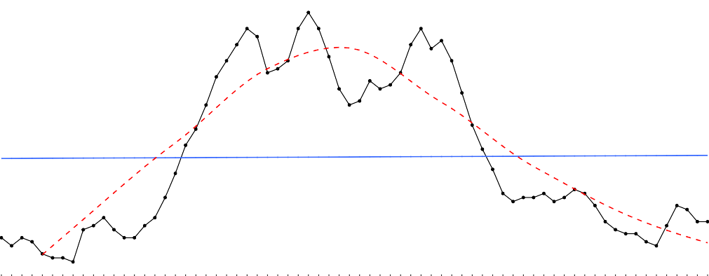
Homicide Rates, 1950 - 2019 Time Series with (Better) Trend Line
10
8
hom_rate
6
4
1950
1951
1952
1953
1954
1955
1956
1957
1958
1959
1960
1961
1962
1963
1964
1965
1966
1967
1968
1969
1970
1971
1972
1973
1974
1975
1976
1977
1978
1979
1980
1981
1982
1983
1984
1985
1986
1987
1988
1989
1990
1991
1992
1993
1994
1995
1996
1997
1998
1999
2000
2001
2002
2003
2004
2005
2006
2007
2008
2009
2010
2011
2012
2013
2014
2015
2016
2017
2018
2019
factor(year)
Data Analysis (CJUS 6103)
Lecture 01 - Introduction, Types of Variables, LoM, and Data Summarization/Visualization

Slide 64
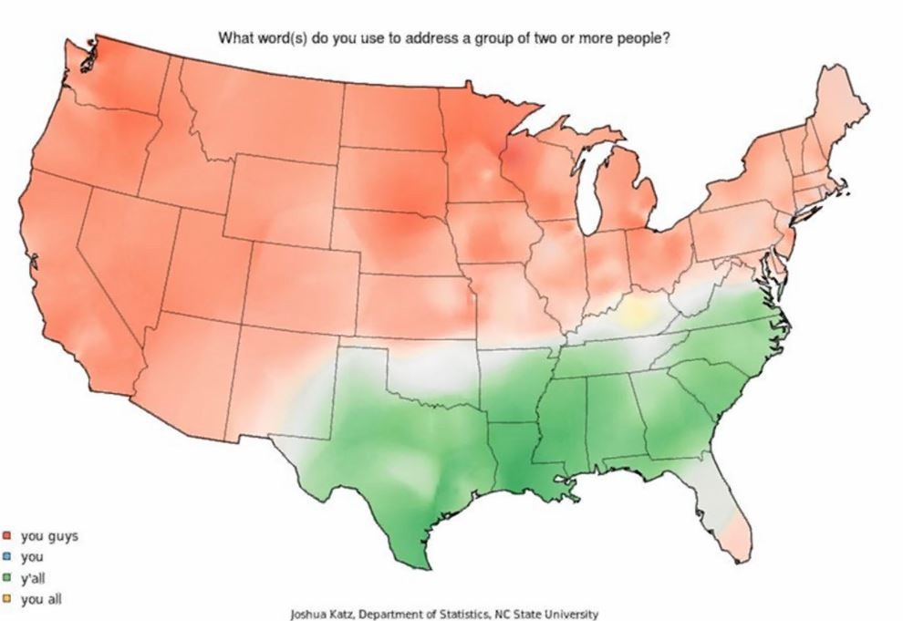
Y’All Use Y’All?
Data Analysis (CJUS 6103)
Lecture 01 - Introduction, Types of Variables, LoM, and Data Summarization/Visualization

Slide 65
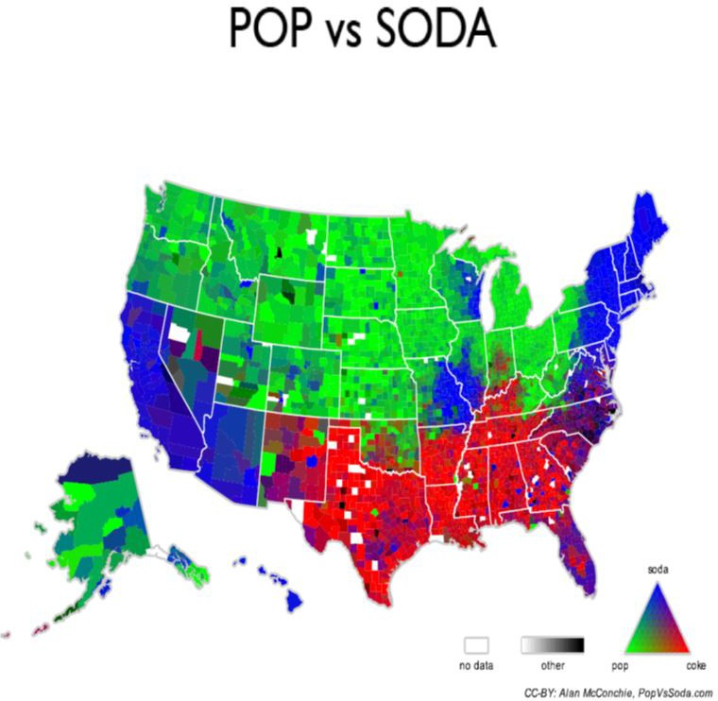
Pop Versus Soda
Data Analysis (CJUS 6103)
Lecture 01 - Introduction, Types of Variables, LoM, and Data Summarization/Visualization

Slide 66
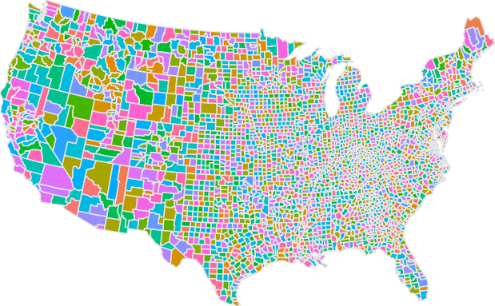
You Can Even Make a Map in R!
Data Analysis (CJUS 6103)
Lecture 01 - Introduction, Types of Variables, LoM, and Data Summarization/Visualization

Slide 67

Time for your Two Questions!
The End
Data Analysis (CJUS 6103)
Lecture 01 - Introduction, Types of Variables, LoM, and Data Summarization/Visualization

